Slide 1
Information And Communication Technologies
Information And Communication Technologies
Information And Communication Technologies
Shaping Today's World and Tomorrow's Potential

Slide 2

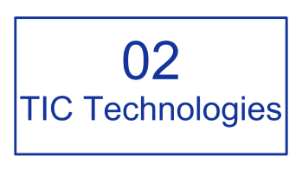







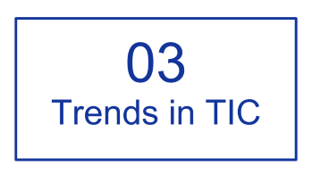
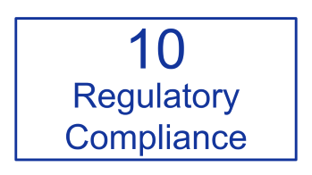
Content

Slide 3
01
Introduction

Slide 4
Introduction
01
ICT, or Information and Communication Technologies, is the invisible thread integrating computers and networks into our daily lives for work, learning, and global communication.

Slide 5
02
TIC Technologies

Slide 6



TIC Technologies
Google Services
Microsoft Tools
Git & Github
Next

Slide 7
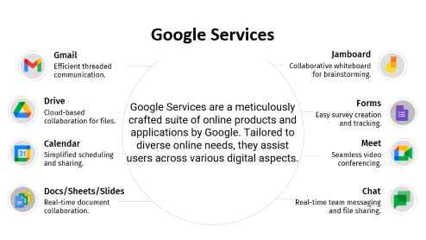
TIC Technologies
Microsoft Tools
Git & Github
Google Services

Slide 8




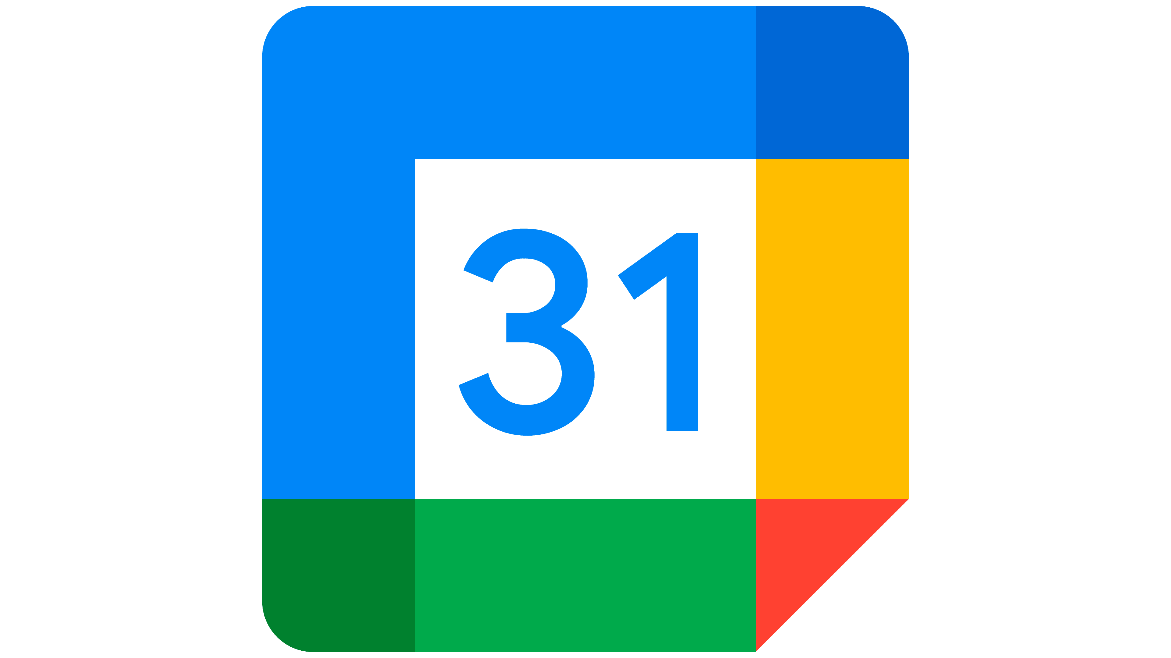



Google Services
Gmail
Jamboard
Efficient threaded communication.
Collaborative whiteboard for brainstorming.
Drive
Google Services are a meticulously crafted suite of online products and applications by Google. Tailored to diverse online needs, they assist users across various digital aspects.
Forms
Cloud-based collaboration for files.
Easy survey creation and tracking.
Calendar
Meet
Simplified scheduling and sharing.
Seamless video conferencing.
Docs/Sheets/Slides
Chat
Real-time document collaboration.
Real-time team messaging and file sharing.

Slide 9
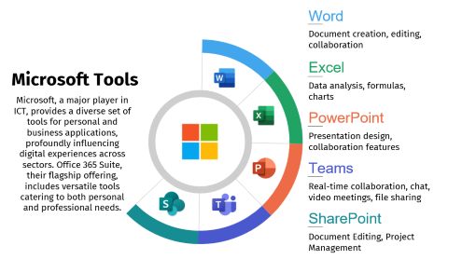
TIC Technologies
Google Services
Git & Github
Microsoft Tools

Slide 10





Word
Document creation, editing, collaboration
Excel
Microsoft Tools
Data analysis, formulas, charts
Microsoft, a major player in ICT, provides a diverse set of tools for personal and business applications, profoundly influencing digital experiences across sectors. Office 365 Suite, their flagship offering, includes versatile tools catering to both personal and professional needs.
PowerPoint
Presentation design, collaboration features
Teams
Real-time collaboration, chat, video meetings, file sharing
SharePoint
Document Editing, Project Management

Slide 11
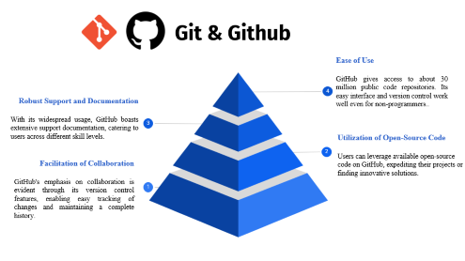
TIC Technologies
Google Services
Microsoft Tools
Git & Github

Slide 12
Git & Github
GitHub is an AI-powered developer platform that allows developers to create, store, and manage their code. It uses Git software, providing the distributed version control of Git plus access control, bug tracking, software feature requests, task management, continuous integration, and wikis for every project.Headquartered in California, it has been a subsidiary of Microsoft since 2018
Ease of Use
GitHub gives access to about 30 million public code repositories. Its easy interface and version control work well even for non-programmers..
4
Robust Support and Documentation
With its widespread usage, GitHub boasts extensive support documentation, catering to users across different skill levels.
3
Utilization of Open-Source Code
Users can leverage available open-source code on GitHub, expediting their projects or finding innovative solutions.
2
Facilitation of Collaboration
GitHub's emphasis on collaboration is evident through its version control features, enabling easy tracking of changes and maintaining a complete history.
1

Slide 13
03
Trends in TIC

Slide 14

Trends in TIC
Information and communication technology (ICT) shapes the digital computing landscape, encompassing a growing array of devices. Global demand for digital services has surged, propelled by the pandemic, accentuating ICT's pivotal role in our lives.

Slide 15
4
Data Management
1
Software
TIC Components
5
Communication Technology
2
Cloud Computing
6
Digital Transactions
3
Internet Services
7
Computer Hardware

Slide 16



ICT will be a key feature of development, aligning with:
01
02
Modern ideas of smart cities
Utilization of renewable sources of energy
ICT
03
Extensive upgrades in network and infrastructure

Slide 17
04
Challenges and Opportunities

Slide 18
The main problems ICT is facing are :
1
Low Level of Accessibility to the Internet
2
Low Level of Income
3
Low Level of Education
4
Low Level of Computer Literacy
5
Cybersecurity threats

Slide 19
ICT’s Opportunities
Innovation
Digital Inclusion
Big Data Analytics
Smart Cities (IoT)
Emerging Technologies

Slide 20
05
Case Studies

Slide 21
Case Studies

Slide 22
06
Future Developments

Slide 23
Future Developments
Augmented Reality (AR) and Virtual Reality (VR) Innovations
Artificial Intelligence (AI) Advancements
Advancements in ICT allows us to have a boundless imagination where cool and futuristic ideas exist.
ICT
Biometric Technologies
Internet of Things (IoT) Expansion
5G Technology
Smart Homes

Slide 24
07
TIC in Education

Slide 25
TIC in Education
integrating ICT into education transforms learning, shaping the landscape, fostering innovation, and enhancing learning experiences.
01
Centralized platforms for course management
Key Technologies in Education
Learning Management Systems
Online Collaboration Tools
02
Facilitating real-time collaboration and discussion
Virtual Classrooms
Educational Apps
03
Interactive online environments for live classes
04
Applications designed for educational purposes

Slide 26
08
Data Privacy and Security

Slide 27
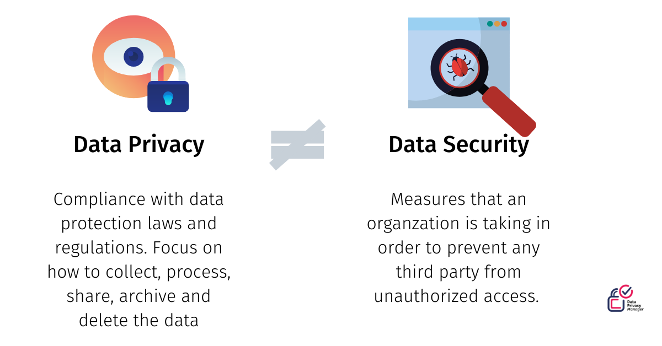

Data Privacy and Security
how to keep information safe online:
1. Encrypt data for security.
2. Choose secure data storage, back up regularly.
3. Train employees on data protection.
4. Conduct regular security audits with third-party experts
Data Privacy
Data Security
Protection of personal information, ensuring control and responsible handling.
Safeguarding data from unauthorized access, breaches, and damage through technology and policies.

Slide 28
09
TIC in Business

Slide 29
TIC in Business
In today's business landscape, Information and Communication Technology (ICT) is indispensable. Through Intranet, Extranet, e-commerce websites, software robots, servers, and cloud technologies, businesses achieve seamless integration and efficiency. This strategic use of ICT optimizes inventory management, enhances customer relations, and fosters adaptability, making it a cornerstone for competitiveness and innovation in the digital era.

Slide 30



TIC in Business
Examples
Amazon
Amazon Chime for online meetings and communication.
Walmart
Workplace by Facebook for group communication and video calls.
Slack
Internal messaging, file sharing, and video calls.

Slide 31
10
Regulatory Compliance

Slide 32
Regulatory Compliance
In ICT, regulatory compliance, including GDPR and HIPAA, is vital for ethical practices and safeguarding sensitive information. Microsoft Corporation and other organizations navigate this complex landscape to adhere to data protection, privacy, and industry standards.

Slide 33
Made By:
BOUZID Djamila Yasmine
LOUAIL Wissam
Thank You
CHABANE Rym
MOUSSAOUI Meriem Nada
DAHDAH Leticia
Section: B

